Slide 1

Inayatus Sholikhah
Graduated from Statistics major
As a mentor at Algoritma since Feb 2019
Know me better https://github.com/inytss/

Slide 2
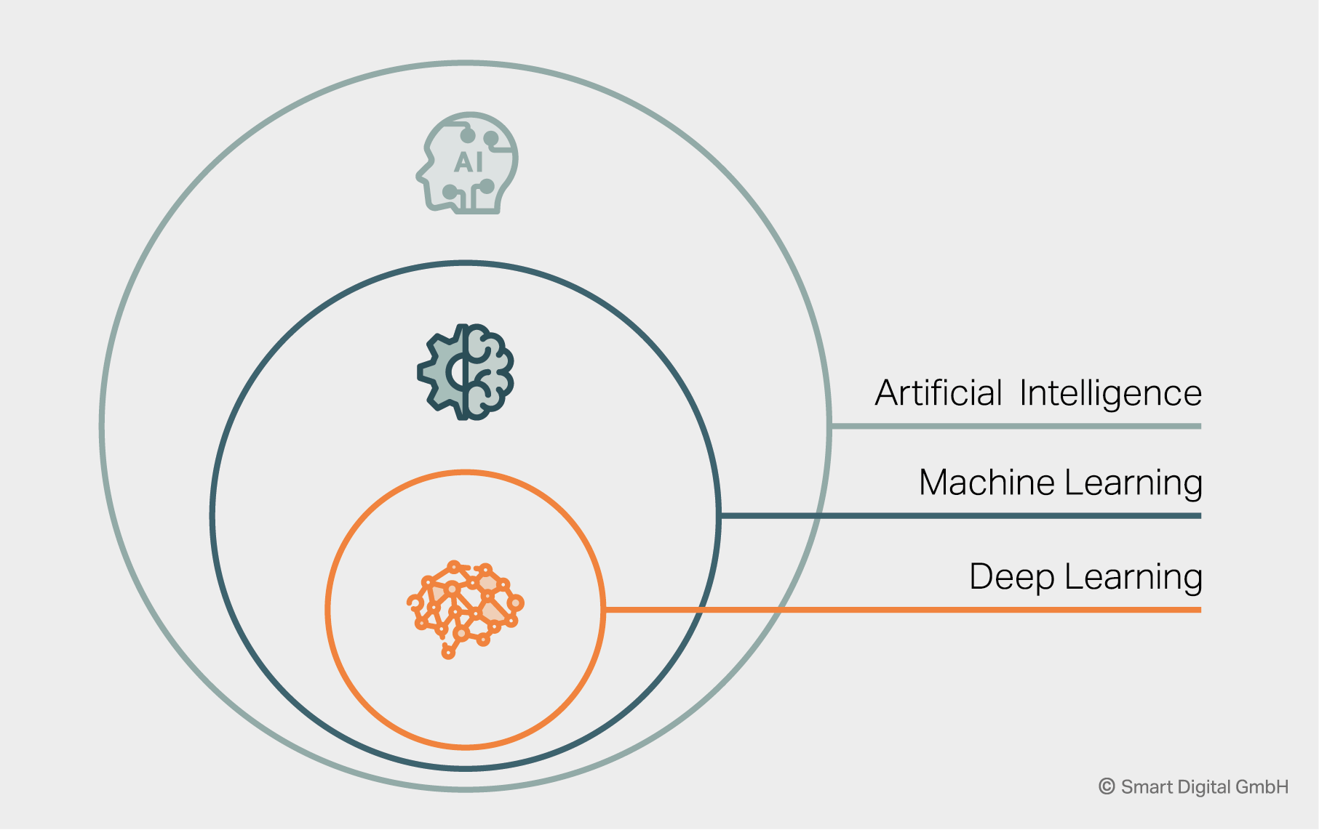
Source: https://www.smart-digital.de/en/beyond-the-hype-ai-machine-learning-and-deep-learning-explained/
Notes:
Artificial Intelligence: cabang Computer Science yang berkutat dengan bagaimana membuat kecerdasan buatan agar program yang dihasilkan dapat me-mimik fungsi kognitif manusia
Machine Learning: menggunakan data untuk melakukan prediksi atau menemukan pola data tanpa diprogram secara eksplisit (seperti pada pembahasan sebelumnya)
Deep Learning: subset dari ML yang mana menggunakan neural network dan memanfaatkan data yang jumlahnya banyak, mengambil ide dari koneksi neuron pada otak manusia, sering disebut sebagai jaringan saraf tiruan. Konsep: belajar dari kesalahan

Slide 3
What is Machine Learning?
Machine learning (ML) is the scientific study of algorithms and statistical
models that computer systems use to perform a specific task without
using explicit instructions, relying on patterns and inference instead. It
is seen as a subset of artificial intelligence. Machine learning algorithms
build a mathematical model based on sample data, known as “training
data”, in order to make predictions or decisions without being explicitly
programmed to perform the task.

Slide 4
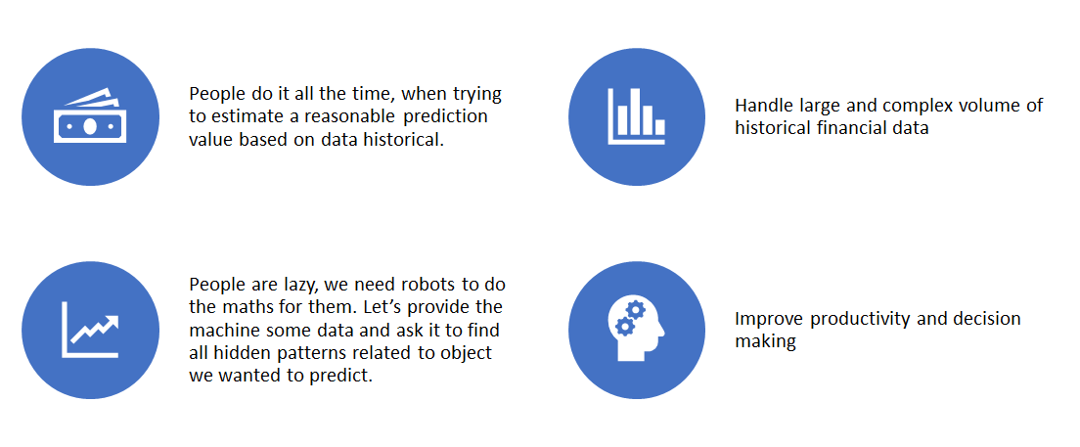
Why do we want machine to learn?

Slide 5
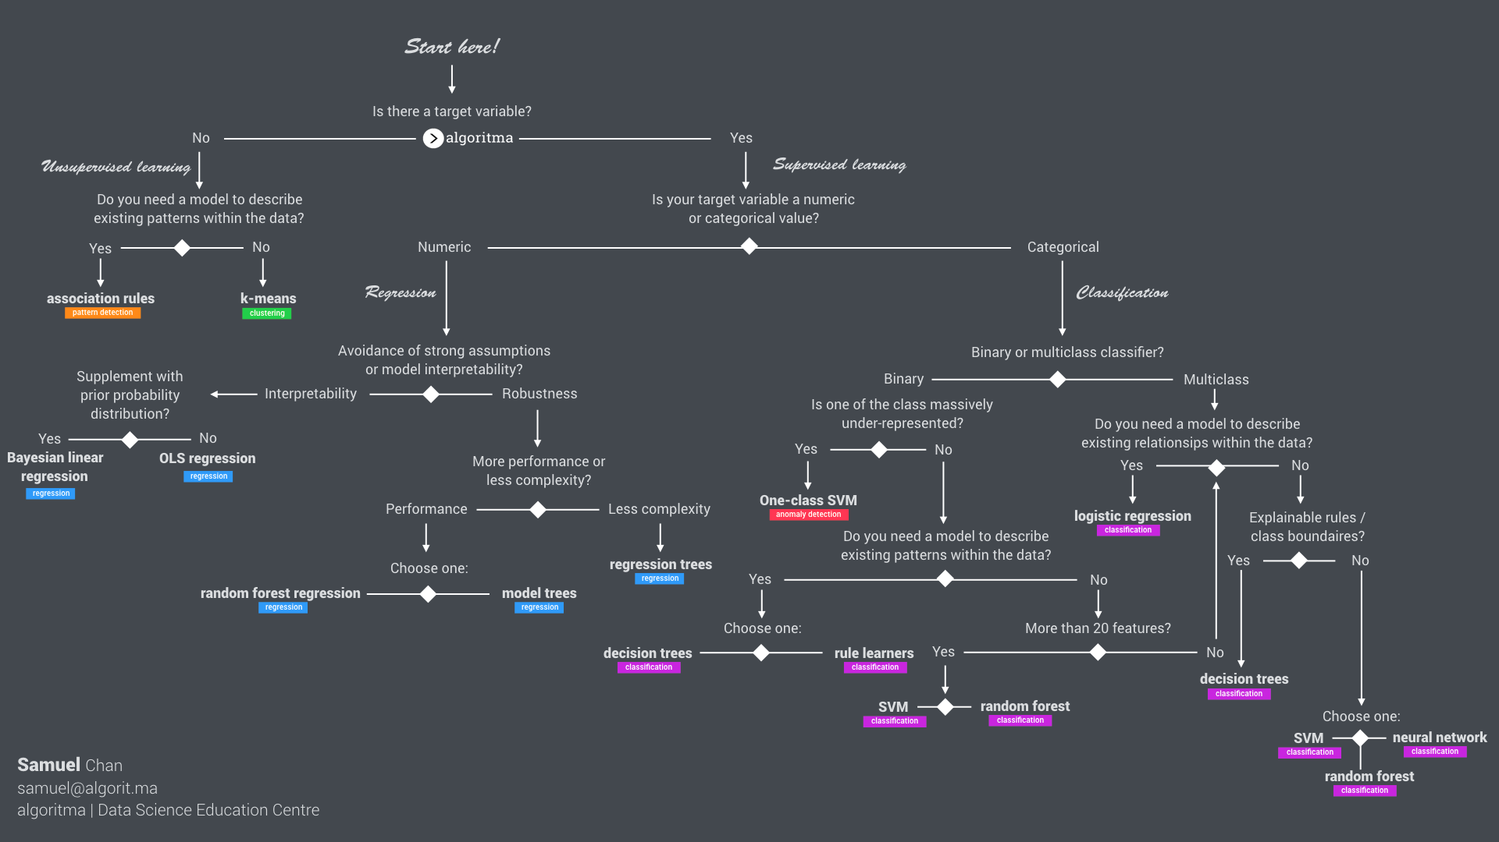

Slide 6
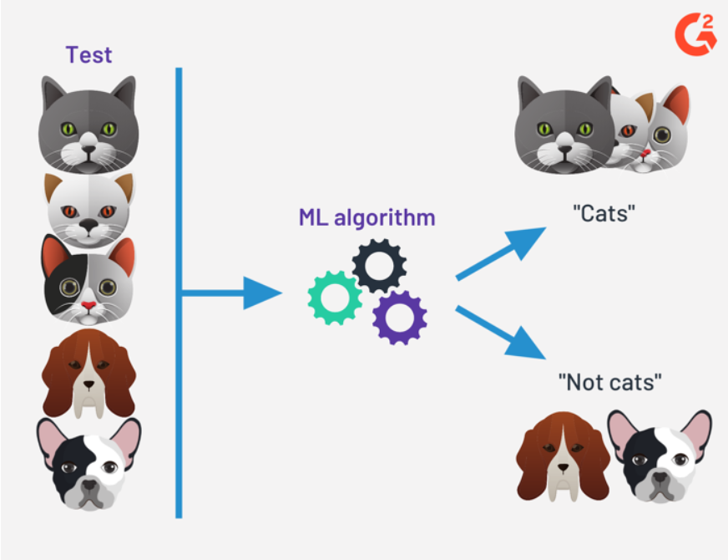
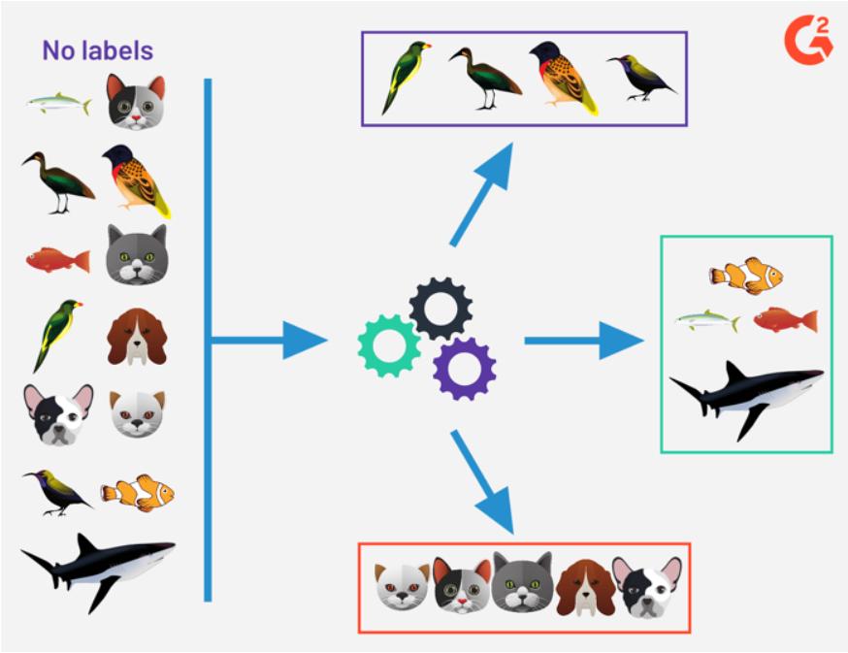
Supervised & Unsupervised
Supervised Learning
Memiliki target variabel:
X1, X2, X3, ..., Xn -> predict Y
Unsupervised Learning
Tidak memiliki target variabel
X1, X2, X3, ..., Xn -> identified pattern

Slide 8
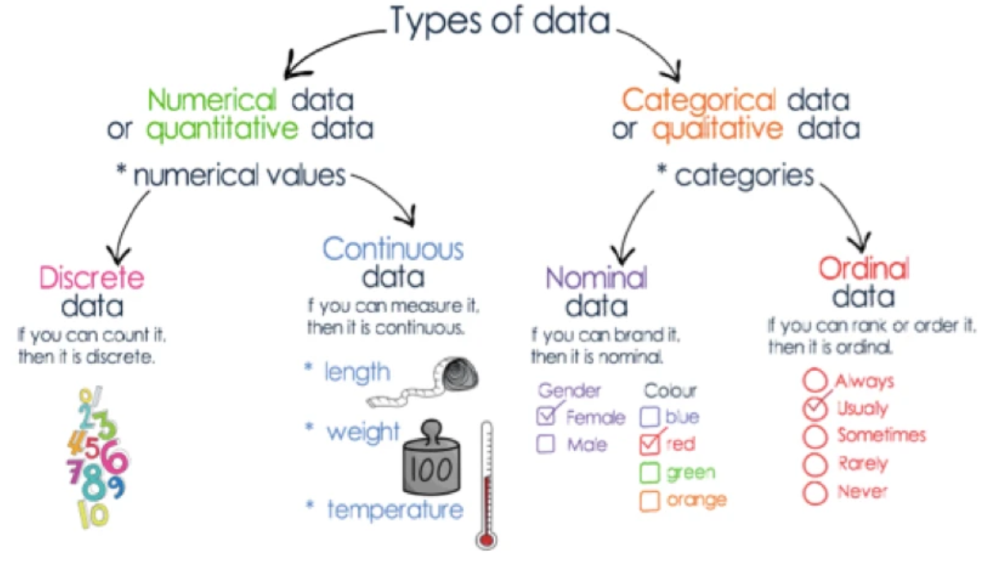

Slide 9
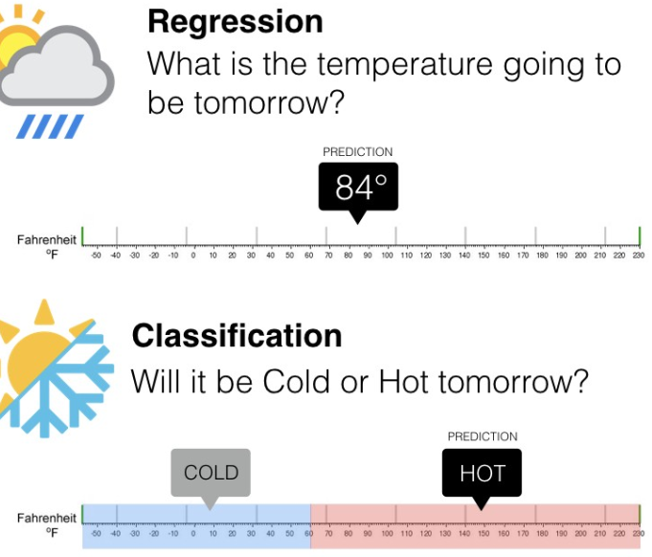
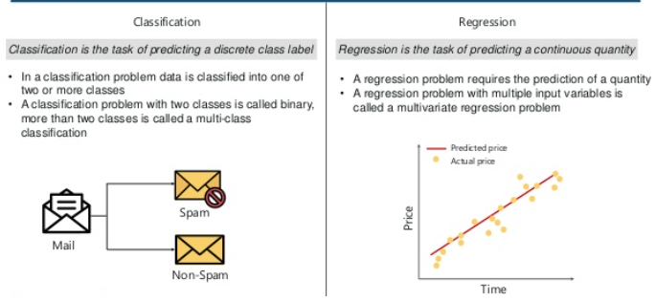

Slide 10
In order to understand regression analysis fully, it’s essential to comprehend the following terms:
Dependent Variable/Target Variable: This is the main factor that you’re trying to understand or predict. (continuous)
Independent Variables/Predictor Variable: These are the factors that you hypothesize have an impact on your dependent variable. (continuous/discrete)

Slide 11
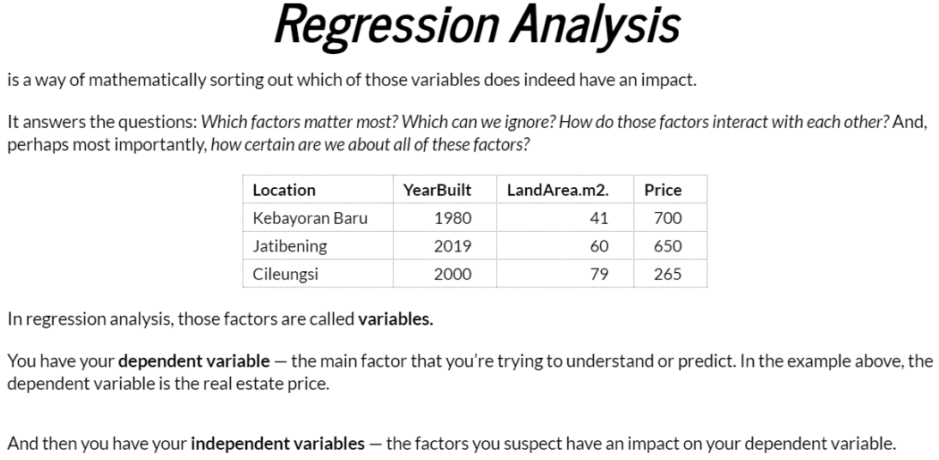

Slide 12
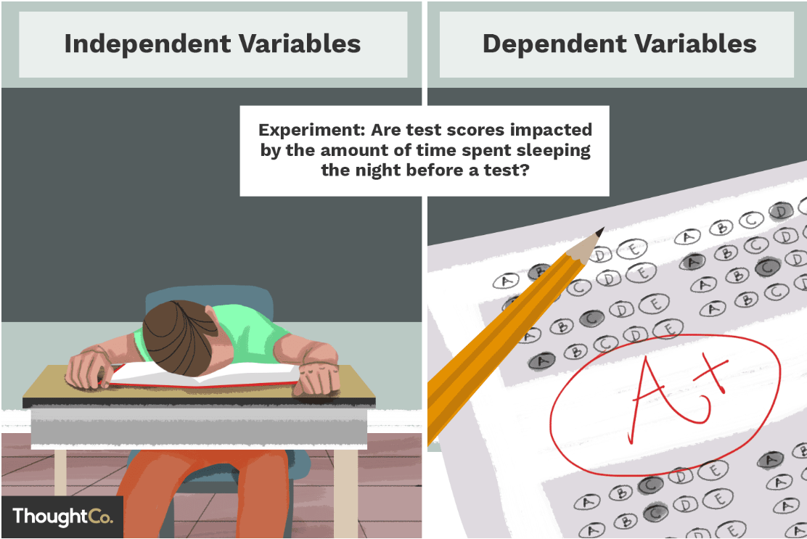

Slide 13
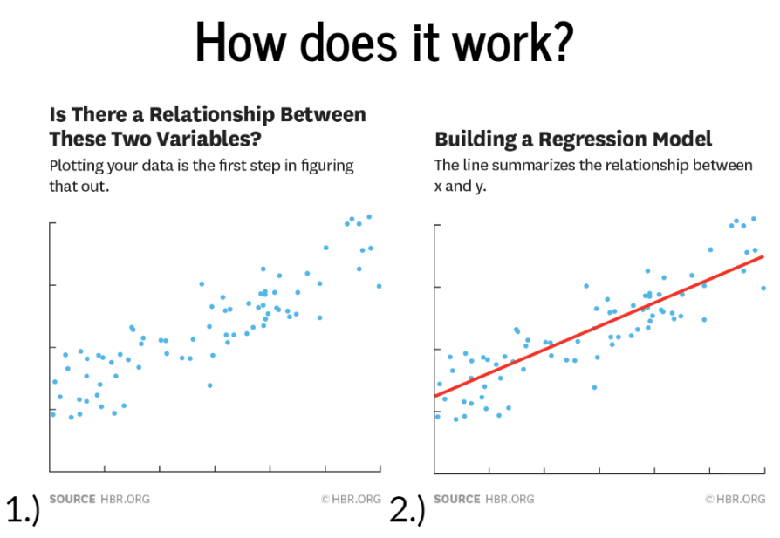

Slide 14
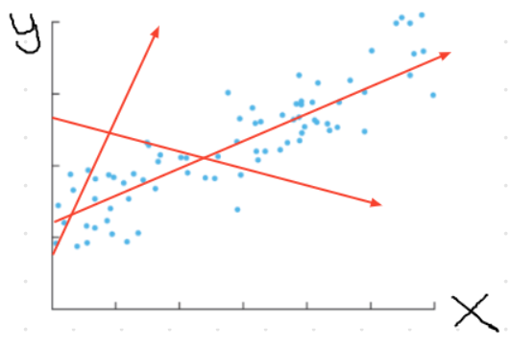
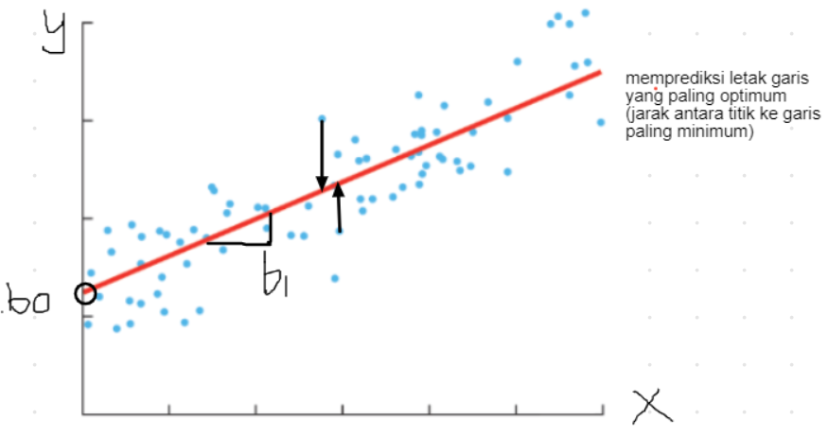

Slide 15
